Slide 1
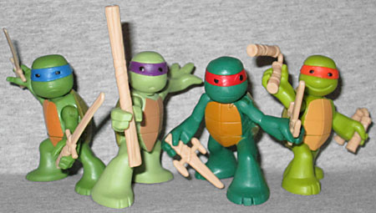
Ninjas in training

Slide 2
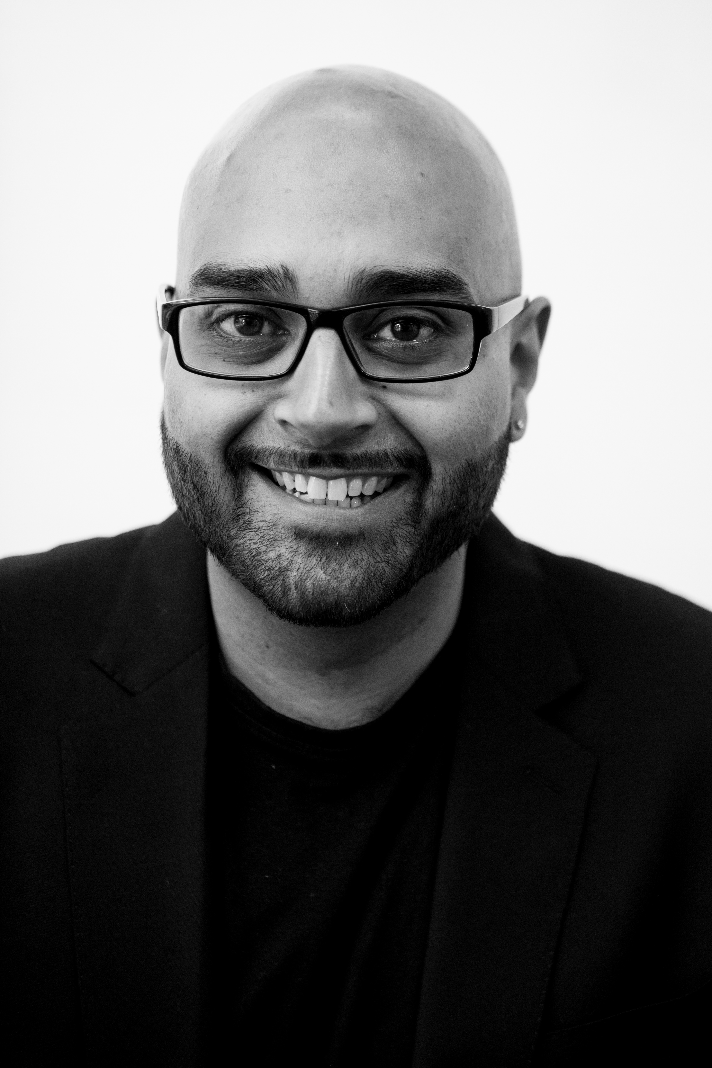

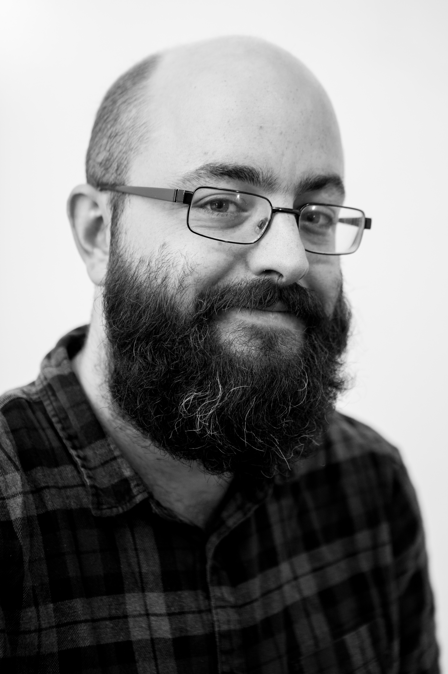
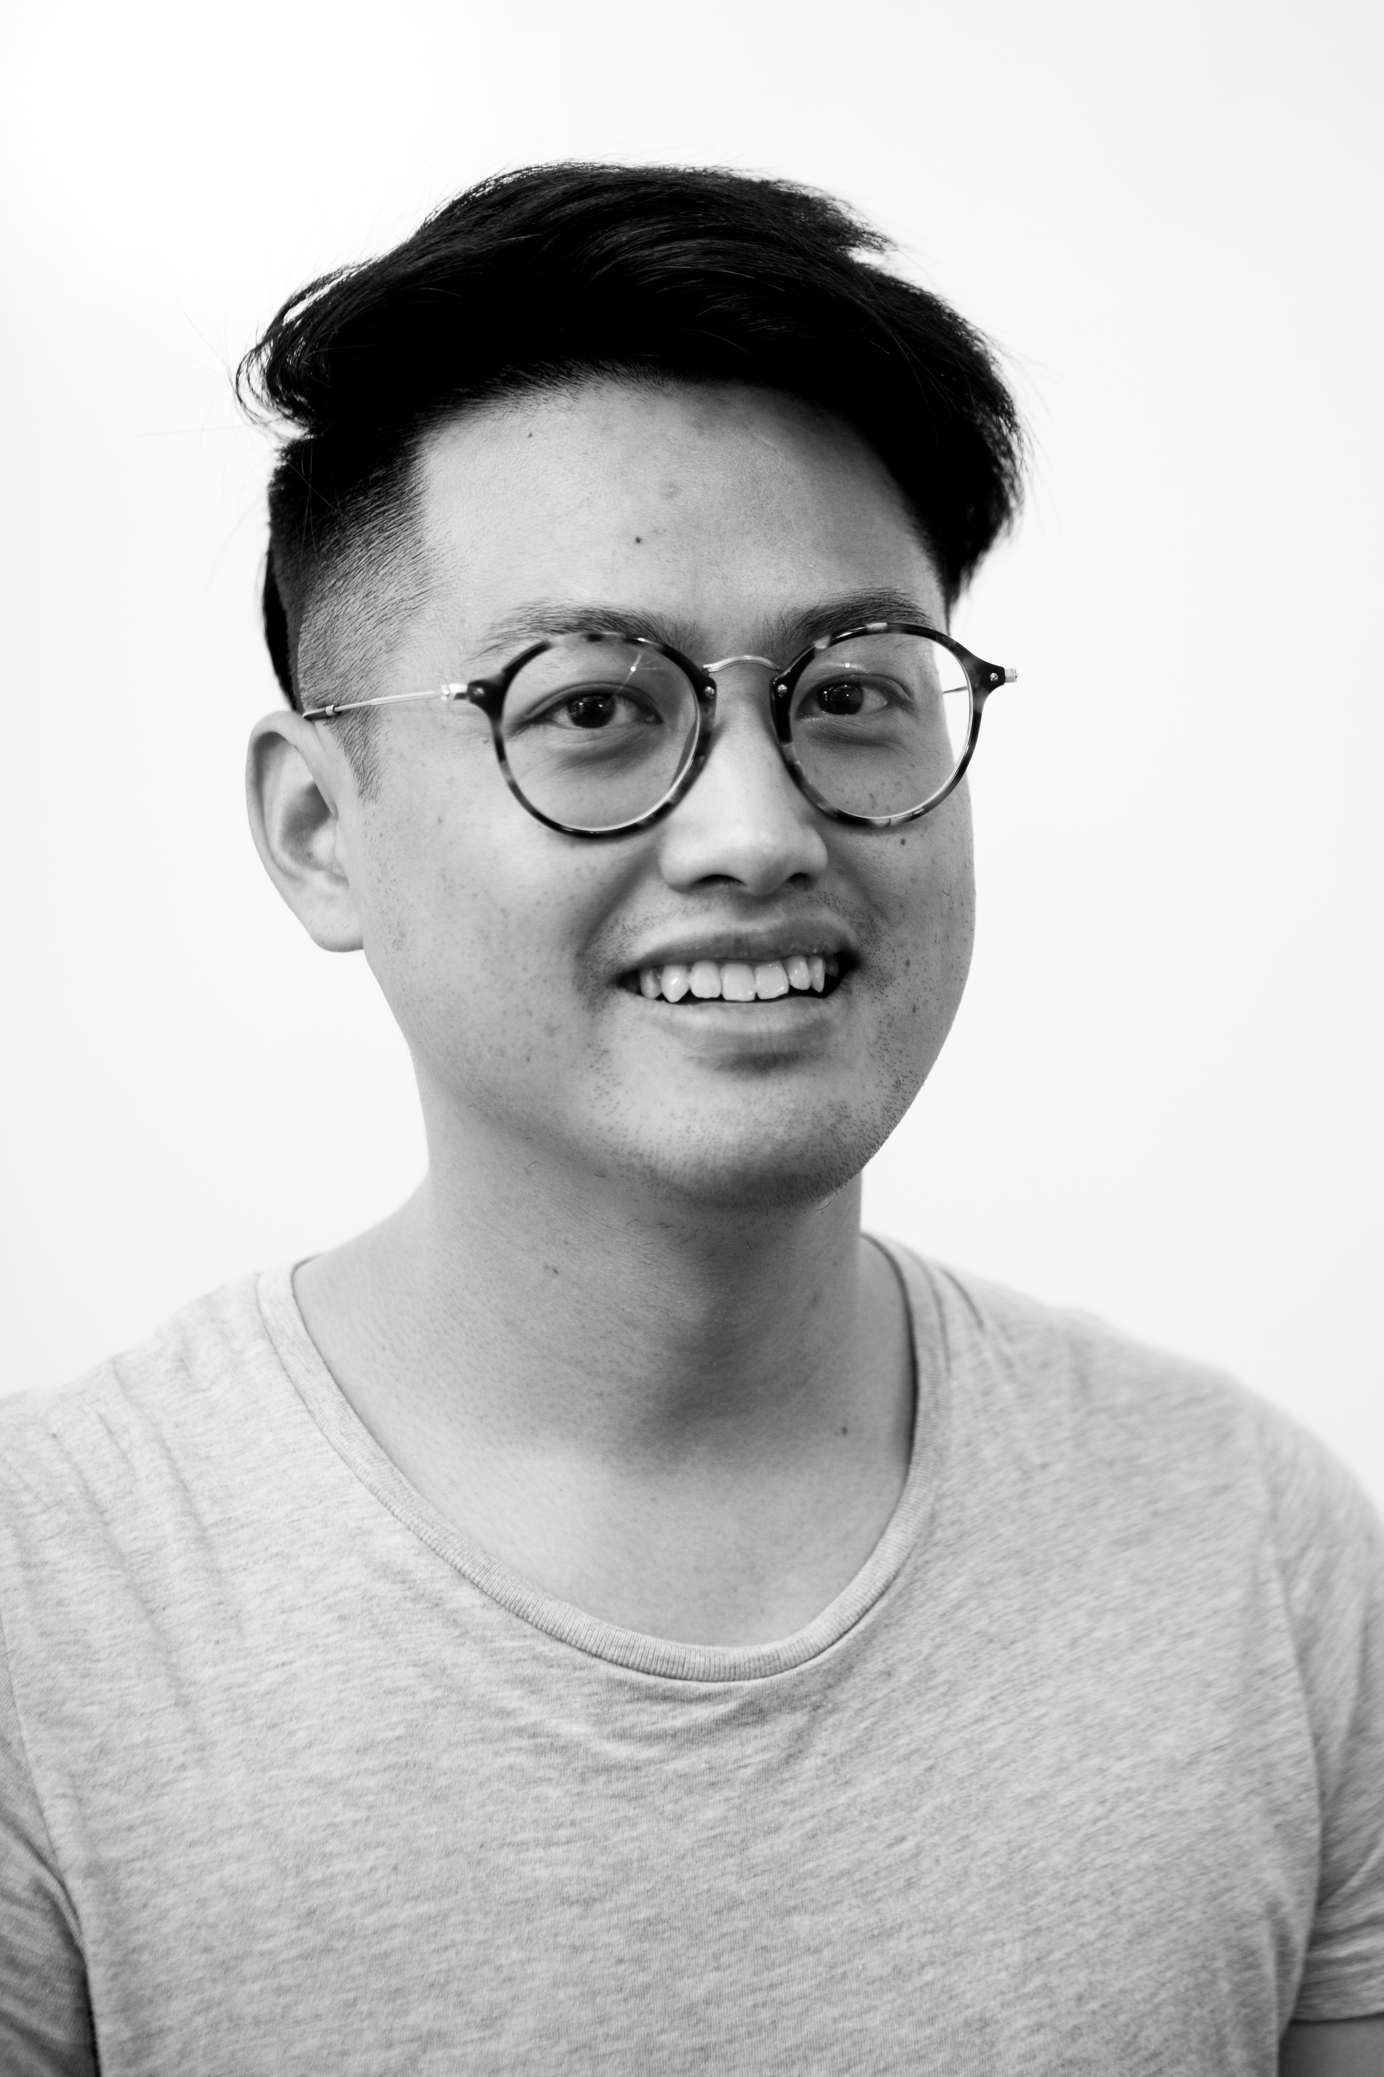
Team

Slide 3
Our Idea
We are changing the way that people organise their night out.
OutApp allows you to plan your night in advance: from creating an event that you can discuss with your friends to providing attendees with the ability to converse with one another in the build up to the event.

Slide 4
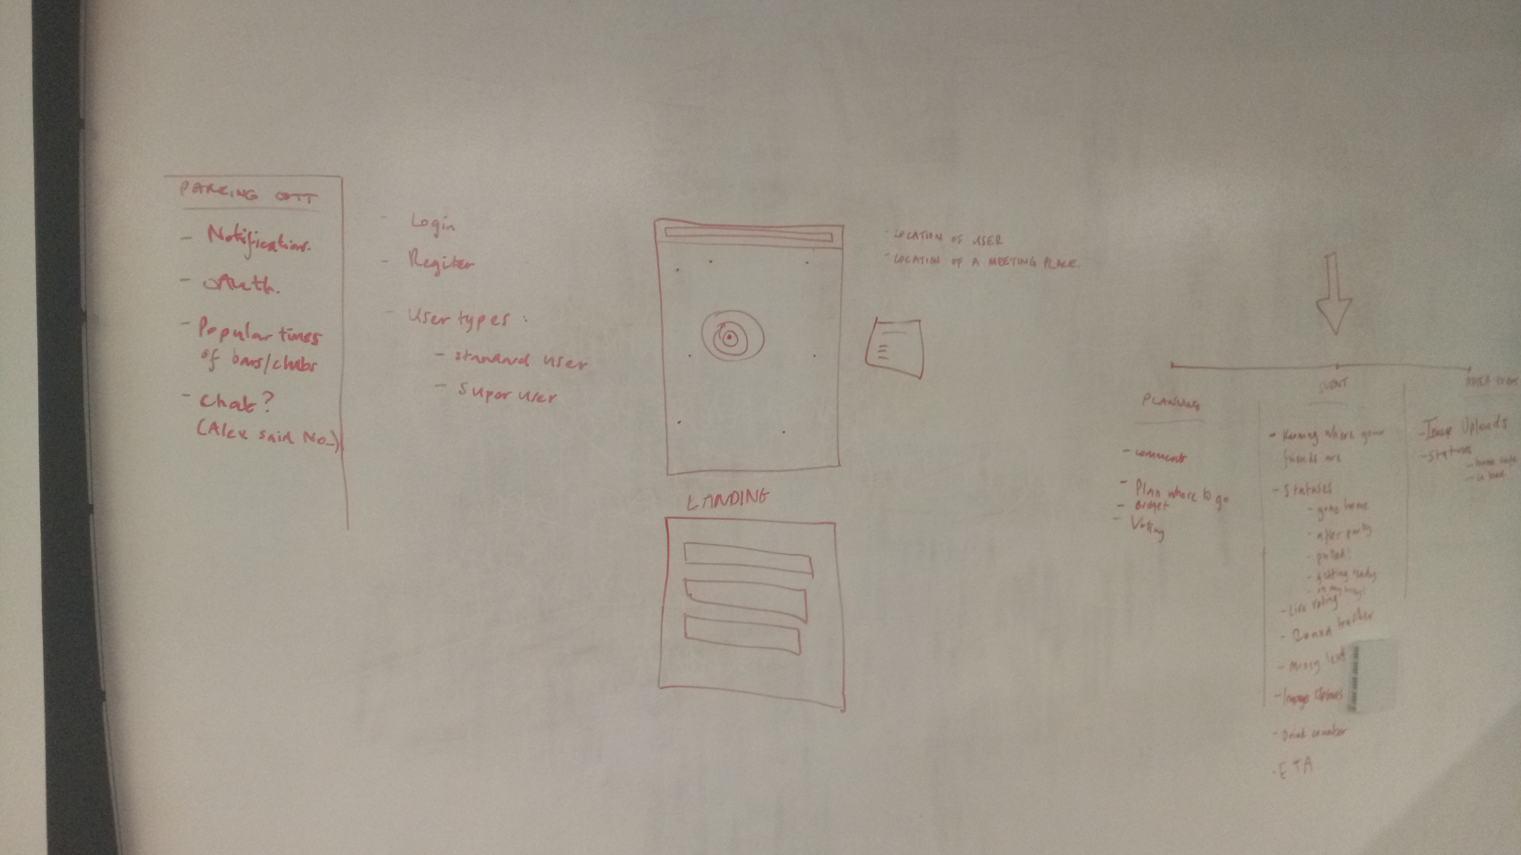
Initial ideation and feature brainstorming…

Slide 5
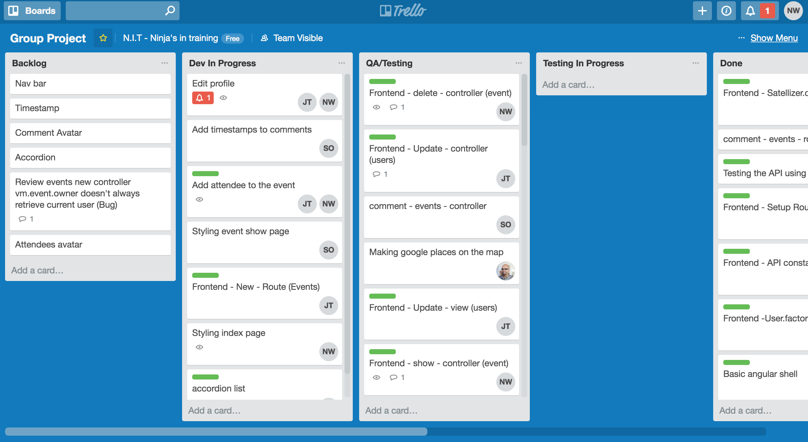
Trello…

Slide 6
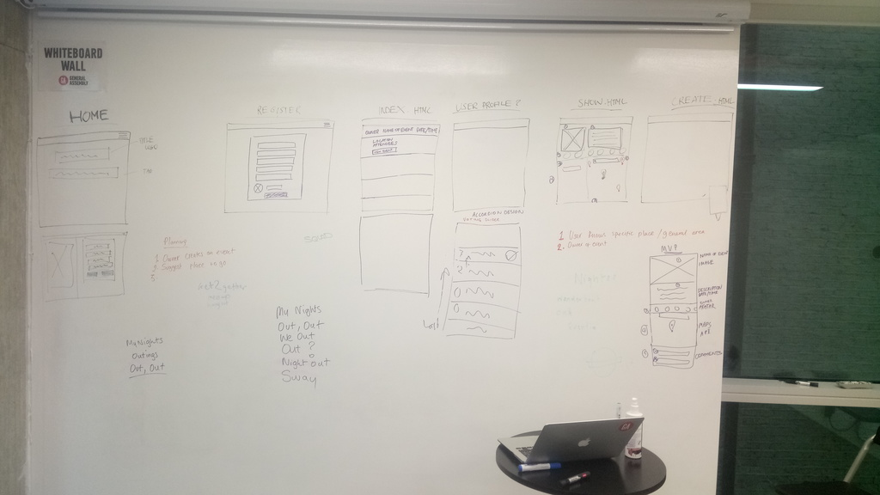
The event show page taking shape…

Slide 7
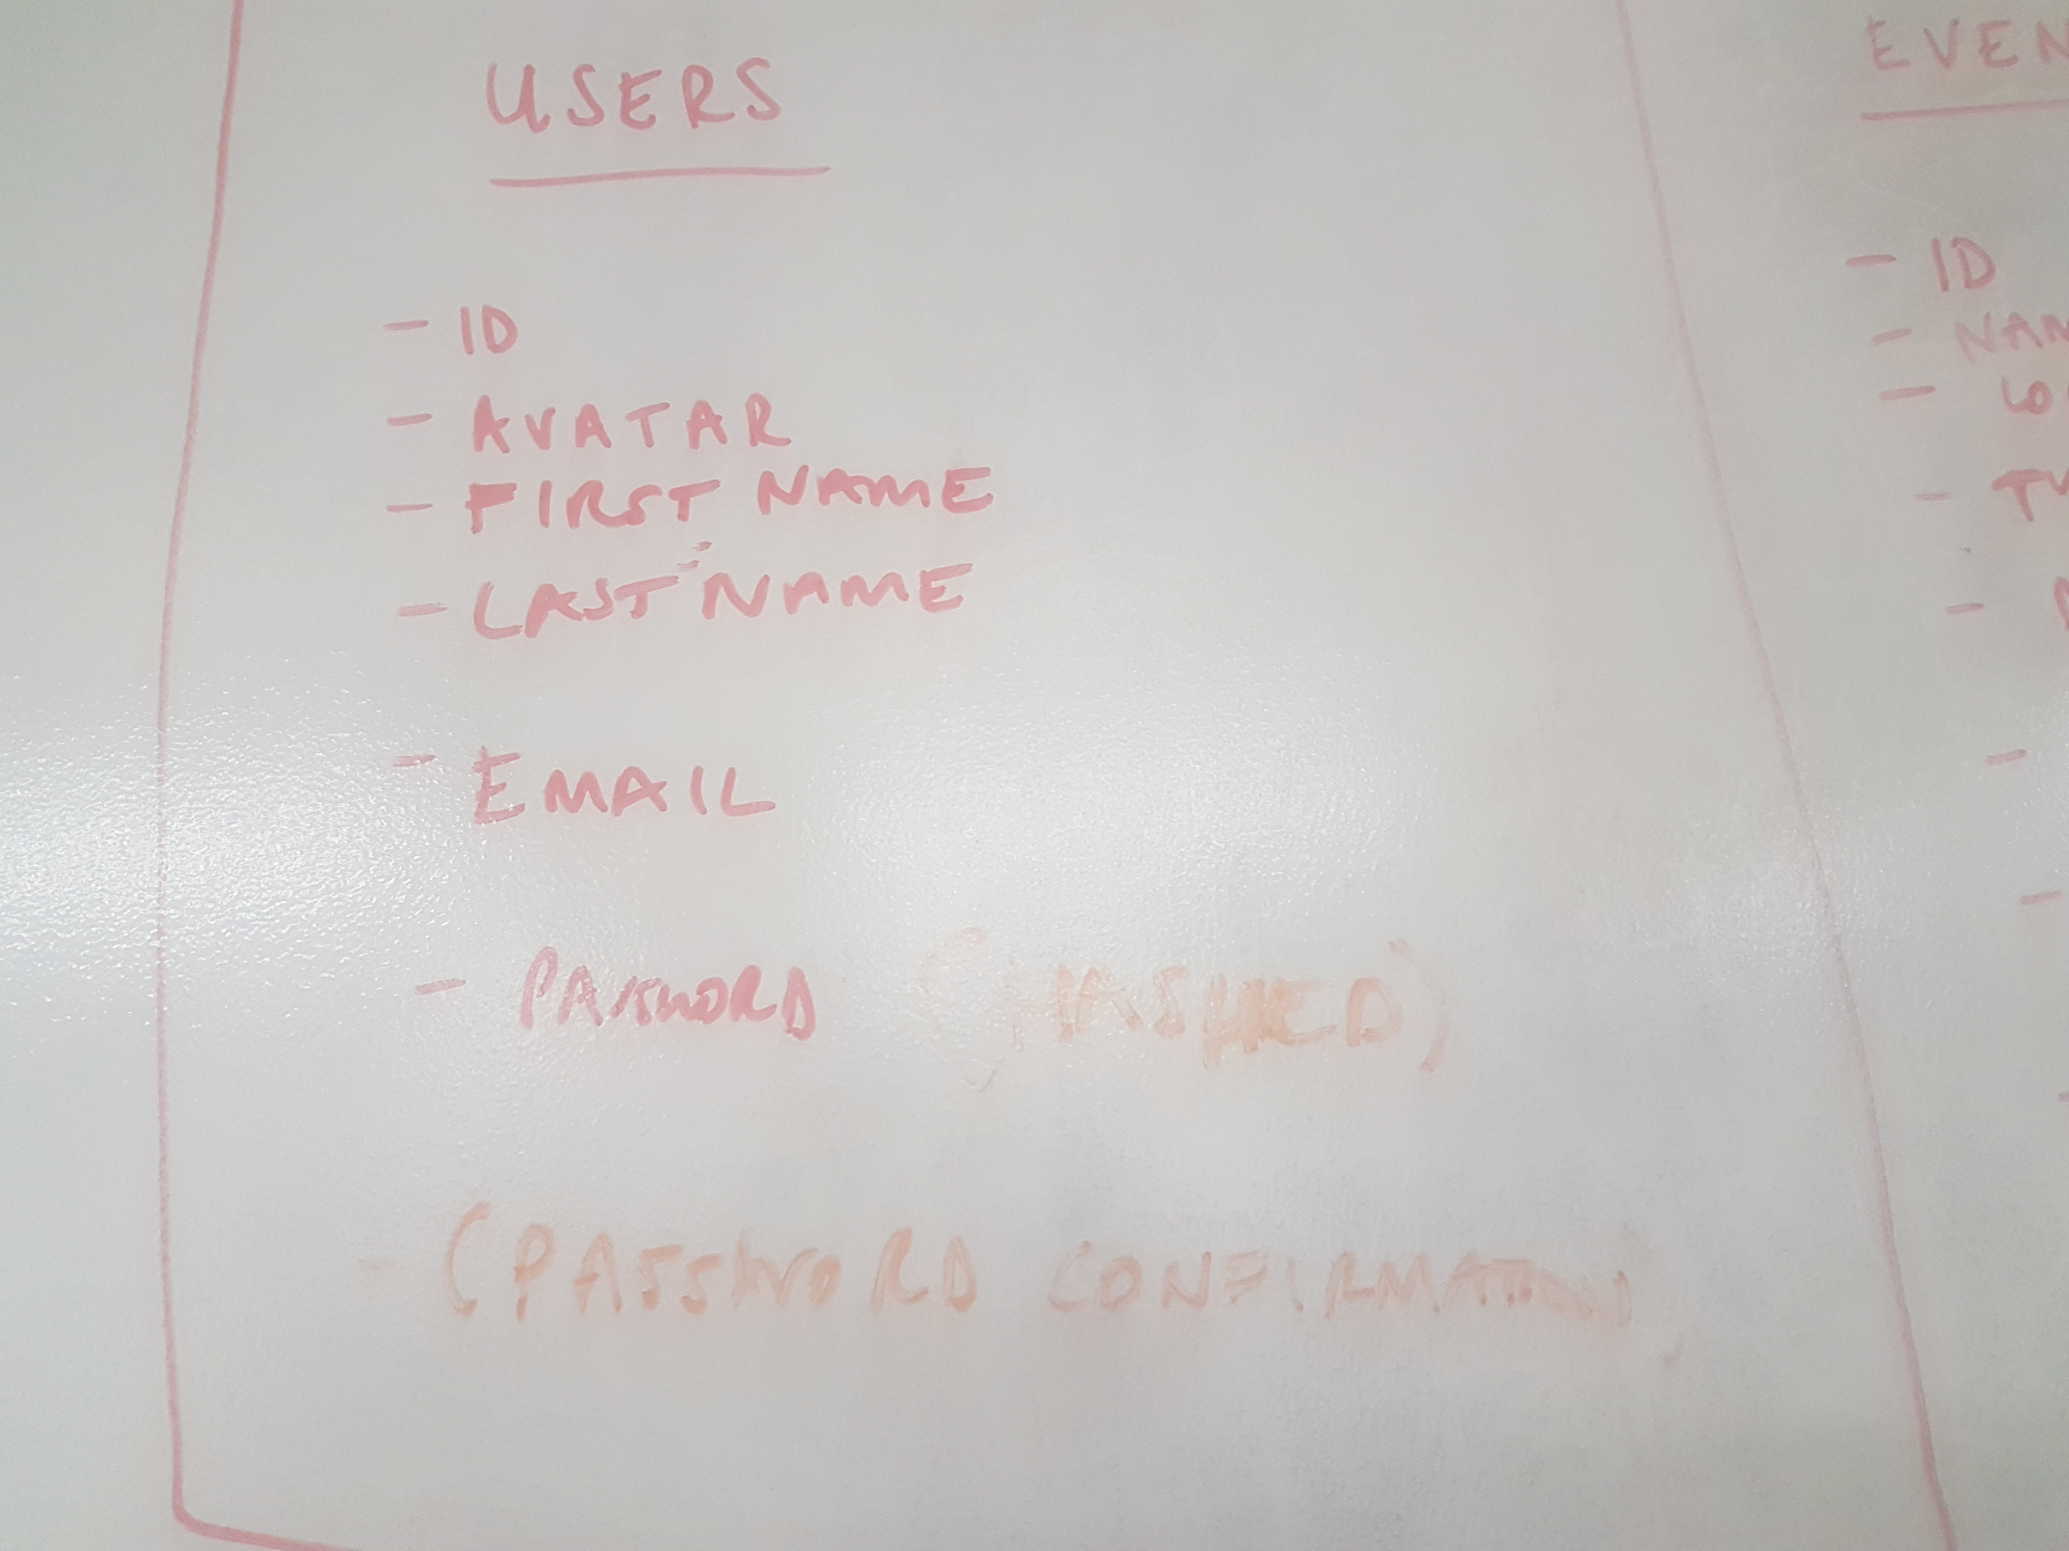
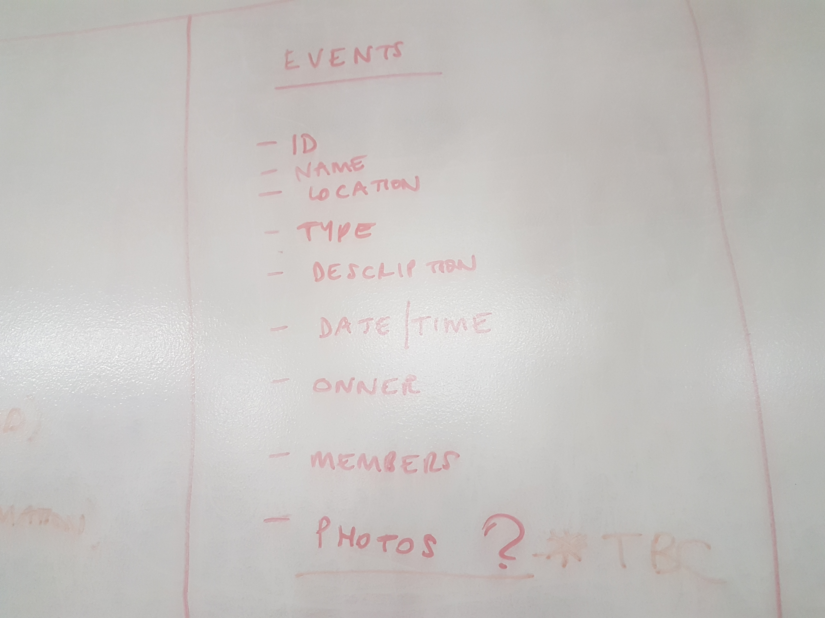
Planning the users / events schemas…

Slide 8
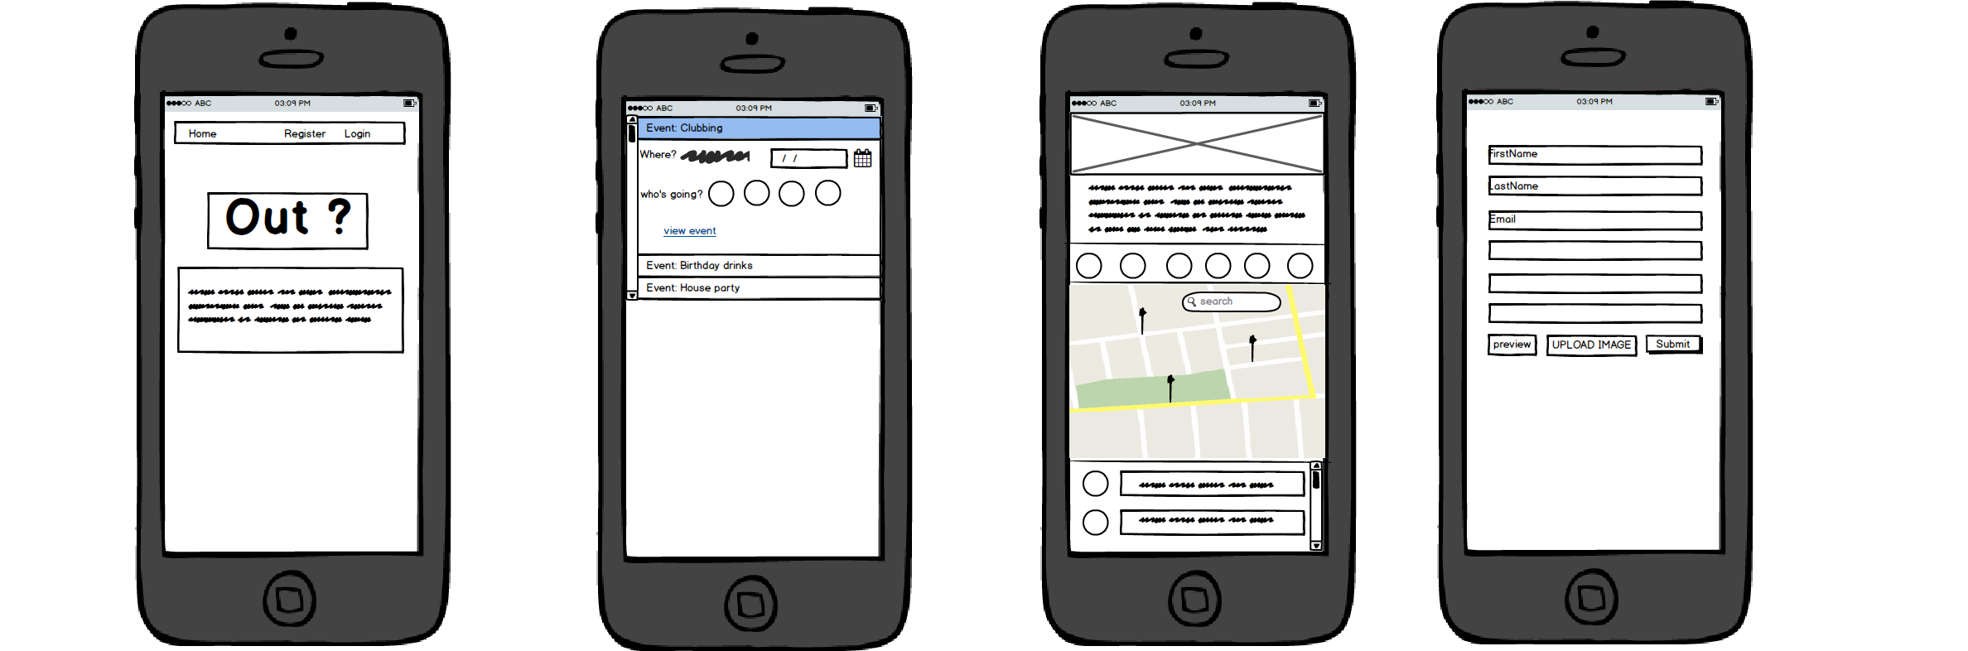
Wireframes…

Slide 9
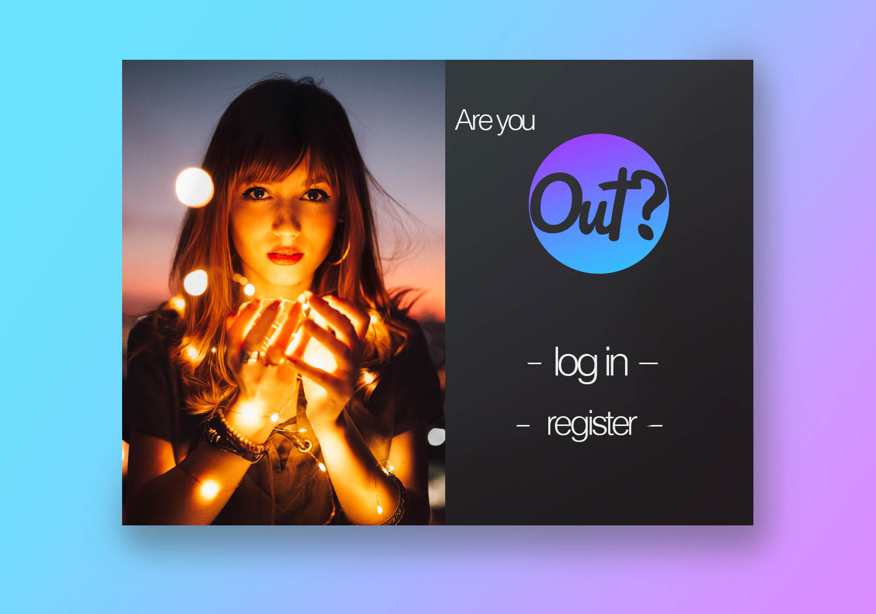
UI exploration

Slide 10
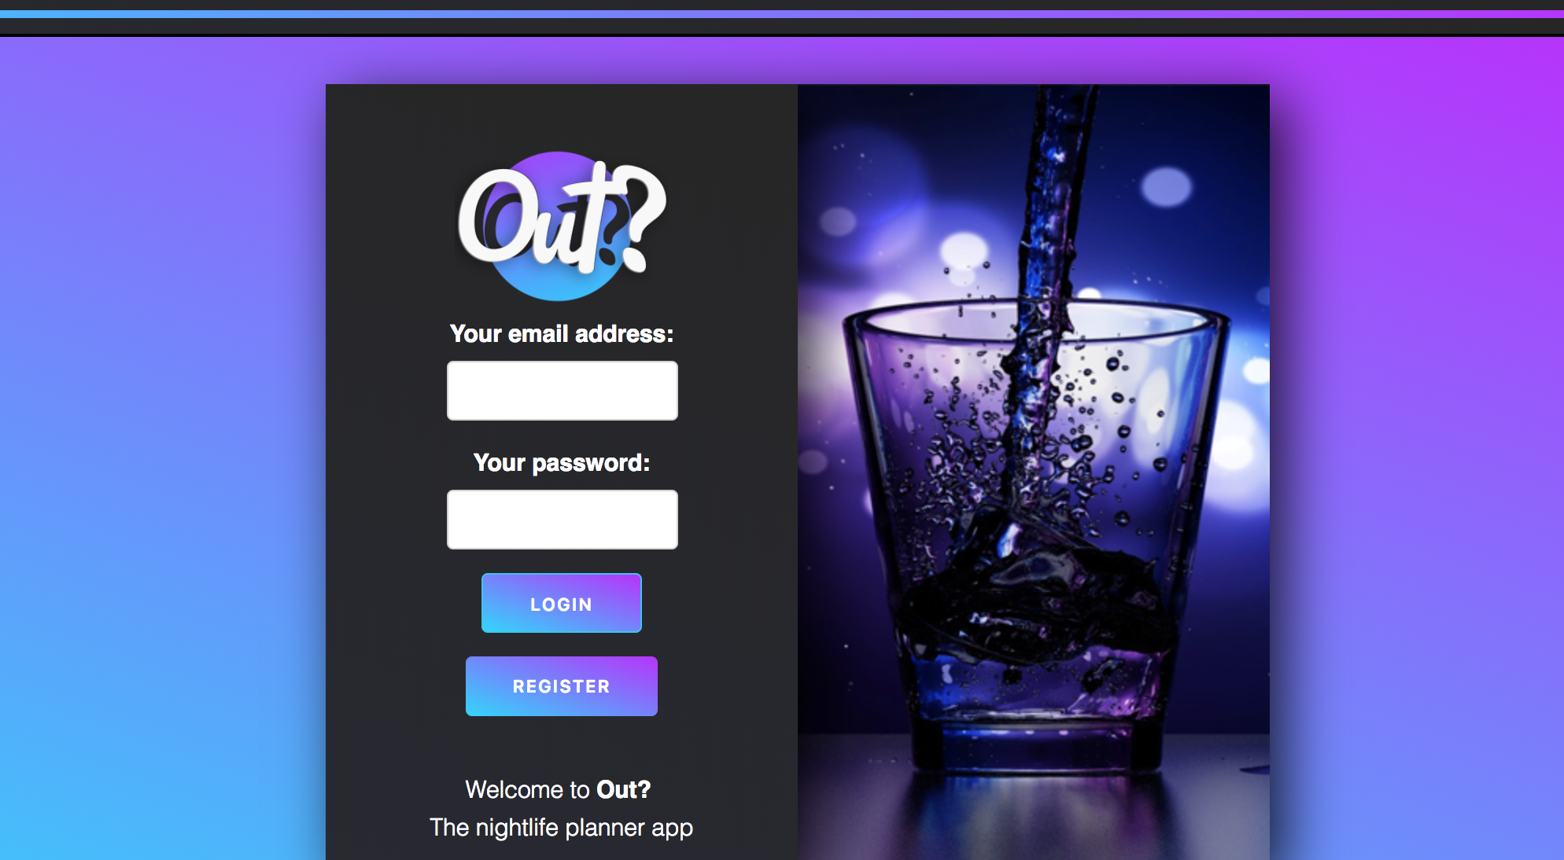
Moving to the finished UI…

Slide 11
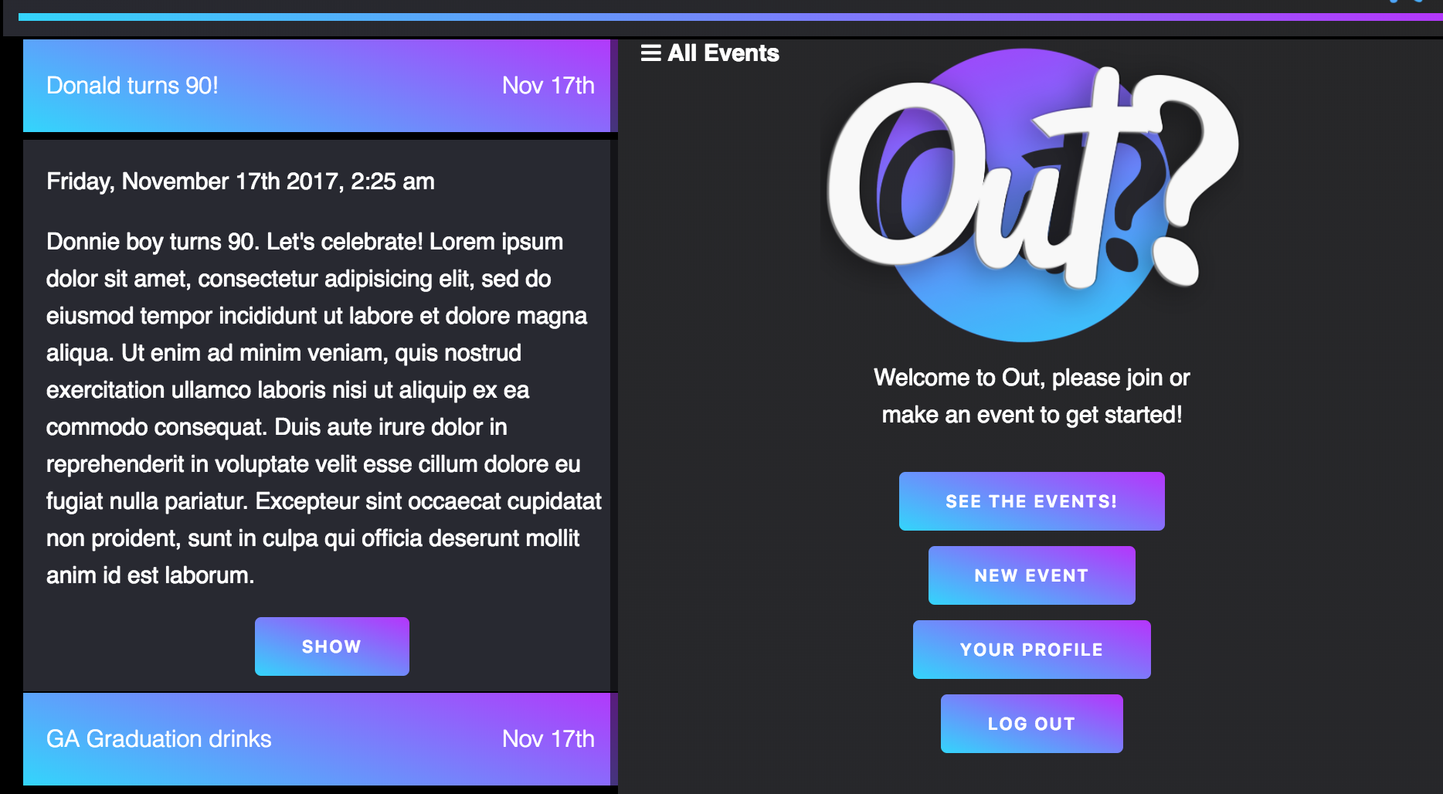
Moving to the finished UI…

Slide 12
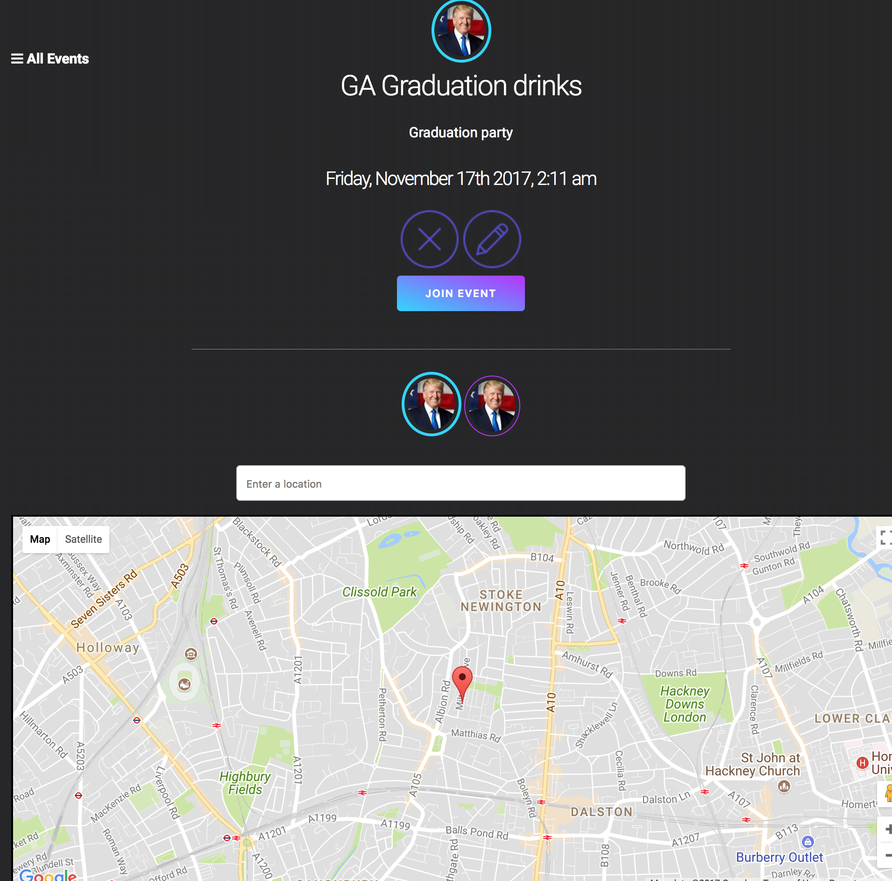
Moving to the finished UI…

Slide 13
Demo
Sandra – overview + comments
Nate - styling
Rupesh – google maps
James – Filestack

Slide 14
What worked well
We were very organized (mostly!)
Initially we successfully planned the project well in Trello. As we got through the bulk of the tickets, we weren't as rigorous with creating new feature tickets
‎James did a good job with implementing file stack upload on edit routes. Nate with logos, UI planning and blitzing through the Backend routes for events. Sandra with SASS and comments. Rupesh with the eventsShow content inc. maps
We naturally ended up playing to each person's strengths as the deadline drew closer
Pair programming: for the best part, we were more productive
Design thinking- we learnt some tips and tricks on UI design, layout and styling from each other. E.g. cool sites for designing gradients, good resources for iconography.

Slide 15
Room for improvement
We took the approach of getting things working basically and then iterating to embellish the product. This worked as a whole but it might have been better to implement the final model from the start rather than iterating on it.
Lots of console errors remaining. Some are due to async nature of Google maps, some are lazy coding- missing closing tags in HTML etc. Unfortunately ran out of time so couldn't fix them.
Communication. We communicated well when together but comms. took a hit when working from home. It wasn't always clear what everyone was working on.
Git flow: on the whole our team did well with git flow but on occasion chevron's from the merge conflict message were left in by the person doing the merge which resulted in console errors.
Time management and common understanding of what is MVP. We didn't have a shared understanding of MVP which ultimately impacted priotisation of features.
We ended up reaching MVP late on Thursday
Do not leave merging everyone’s code to the day of the showcase!

Slide 16
Feature backlog
Fixing bugs!
Code refactoring and tidy up!
Fixing styling!
Finishing the ability for attendees to specify a location preference with the marker head changing to the avatar of the person that dropped the pin
Voting on location suggestions
‎integration with other APIs to get further information about a place to display in the info window
Ability for an event organiser to invite friends to an event + invite acceptance system
Attendee location awareness on the night
About page and tutorial for how to use the app the first time the users signs in
Facebook and Twitter integration – sharing plus authentication
Ability to create a photo album of snaps from the night
Tweak events index so it only displays events that you are interested in rather than all events

Slide 17
Wins!
Successful Google maps/ Google places API integration. Getting the info window to show via a custom Google map directive which then invokes a function within the directive itself. (More work to be done to finish this)
Building the auth system with JWT tokens
Linking events and users on the events show in order to fetch event owner / attendee info and avatar of commenter
‎
Feeling more confident about how to write tests using mocha/chai!
Being able to integrate angular packages that we haven't necessarily learnt in class e.g. angular moments
‎Feeling more comfortable with SCSS and styling generally

Slide 18
Technologies used
MEAN stack application with RESTful routes
Get Skeleton
SASS
Google maps / places APIs
Angular-momentjs
Filestack
Instanbul for testing code coverage
Mocha and Chai for tests
Balsamic for wireframing
Photoshop for UI design
Trello for workflow

